Slide 1



STUDIO SHODWE
TICKET MANAGEMENT SYSTEM FOR CONCERTS

Slide 2

PARENT CLASS
TICKETS
Attributes: ticketID, concertGroup, ticketPrice, timeDate, ticketColor, seat and person.
Methods: set/get methods and printTicket().

Slide 3


CHILD CLASSES
GENERAL TICKET
Attributes: withSeat
Methods: set/get

Slide 4

CHILD CLASSES
GENERAL TICKET
Attributes: withSeat
Methods: set/get

Slide 5



CHILD CLASSES
VIP TICKET
Attributes: backStagePass, meetAndGreet and foodAndDrink
Methods: set/get and printTicket()
GENERAL TICKET
Attributes: withSeat
Methods: set/get

Slide 6
CHILD CLASSES
VIP TICKET
Attributes: backStagePass, meetAndGreet and foodAndDrink
Methods: set/get and printTicket()
GENERAL TICKET
Attributes: withSeat
Methods: set/get

Slide 7

CHILD CLASSES
VIP TICKET
Attributes: backStagePass, meetAndGreet and foodAndDrink
Methods: set/get and printTicket()
GENERAL TICKET
DISCOUNT TICKET
Attributes: withSeat
Attributes: discountType, isDiscounted and finalPrice;
Methods: set/get
Methods: set/get and printTicket()

Slide 8
CHILD CLASSES
VIP TICKET
Attributes: backStagePass, meetAndGreet and foodAndDrink
Methods: set/get and printTicket()
GENERAL TICKET
DISCOUNT TICKET
Attributes: withSeat
Attributes: discountType, isDiscounted and finalPrice;
Methods: set/get
Methods: set/get and printTicket()

Slide 9
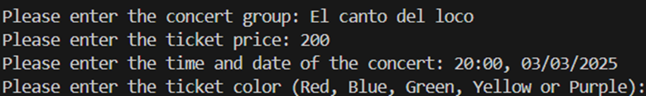

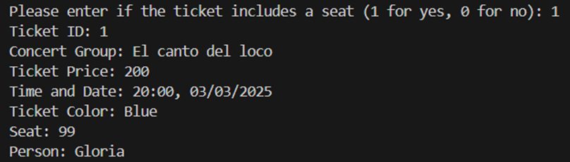
OPERATIONAL FLOW
GENERAL TICKET

Slide 10
OPERATIONAL FLOW
GENERAL TICKET

Slide 11
OPERATIONAL FLOW
GENERAL TICKET

Slide 12
OPERATIONAL FLOW
GENERAL TICKET

Slide 13
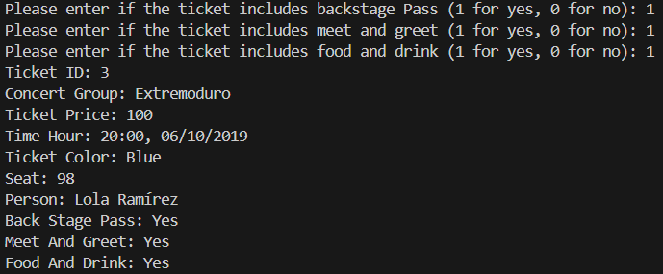
OPERATIONAL FLOW
VIP TICKET

Slide 14
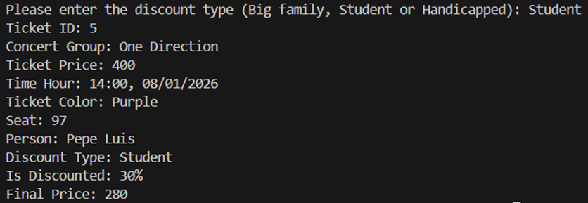

OPERATIONAL FLOW
DISCOUNT TICKET

Slide 15
OPERATIONAL FLOW
DISCOUNT TICKET

